Slide 1
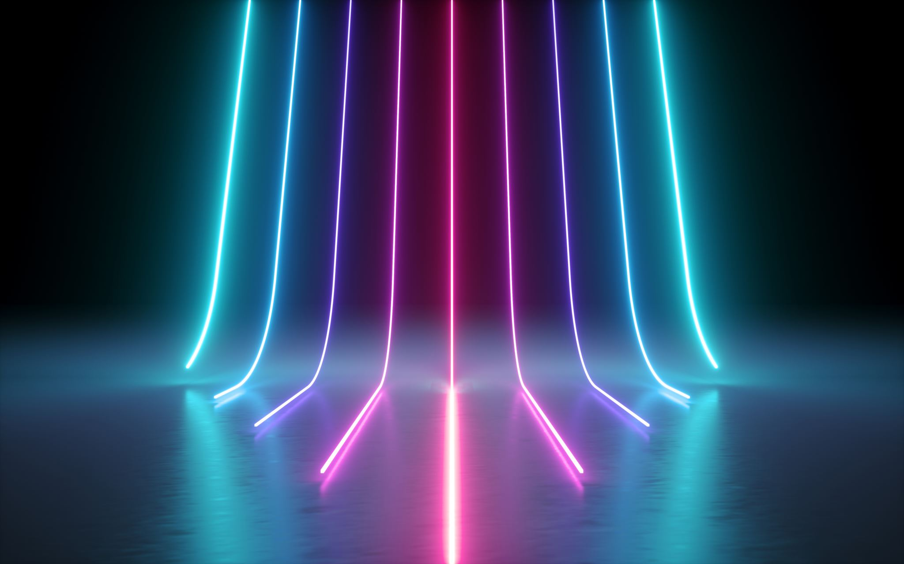


Playlist Generator
Customize your own personal playlist with all your favorite songs!
Project Coder: Kristi Derouen

